Slide 1
Stable diffusion (Latent diffusion)
2024.09.09~12
허성우

Slide 2
Latent Diffusion Models (LDM)
Topics
Latent Diffusion Models (E.g. Stable Diffusion)
Text-to-Image (T2I)
Image-to-Image
Inpainting

Slide 3
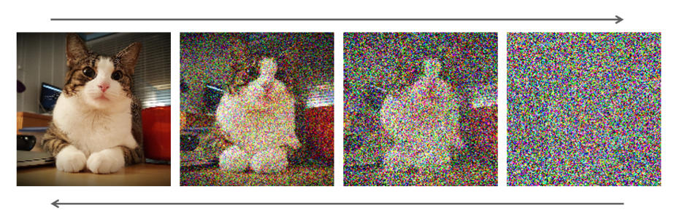
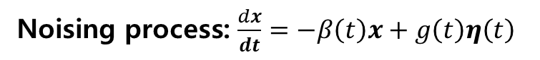
Latent Diffusion Models (LDM)
What is LDM?
So far, we learned generating samples in the original pixel space…
Diffusion in pixel space is computationally costly, due to large state space.
Noising process: $\frac{dx}{dt}=−β\left(t\right)x+g\left(t\right)η\left(t\right)$
Denoising process: $\frac{dx}{dt}=−β\left(t\right)x+g\left(t\right)η\left(t\right)−g{\left(t\right)}^{2}s\left(x,t\right)$
Score function!

Slide 4
Latent Diffusion Models (LDM)
Latent Diffusion Models (LDM)
So now, we’ll be doing it in the latent space!

Slide 5
Latent Diffusion Models (LDM)
Latent Diffusion Models (LDM)
Latent space = Combining Autoencoder with Diffusion
Encoder
Decoder

Slide 6
Latent Diffusion Models (LDM)
Latent Diffusion Models (LDM)
Latent space = Combining Autoencoder with Diffusion
Autoencoders: generate high-resolution details
Diffusion: learn low-resolution, high level information.

Slide 7
Latent Diffusion Models (LDM)
Latent Diffusion Models (LDM)
For conditional generation;
We use cross attention!

Slide 8
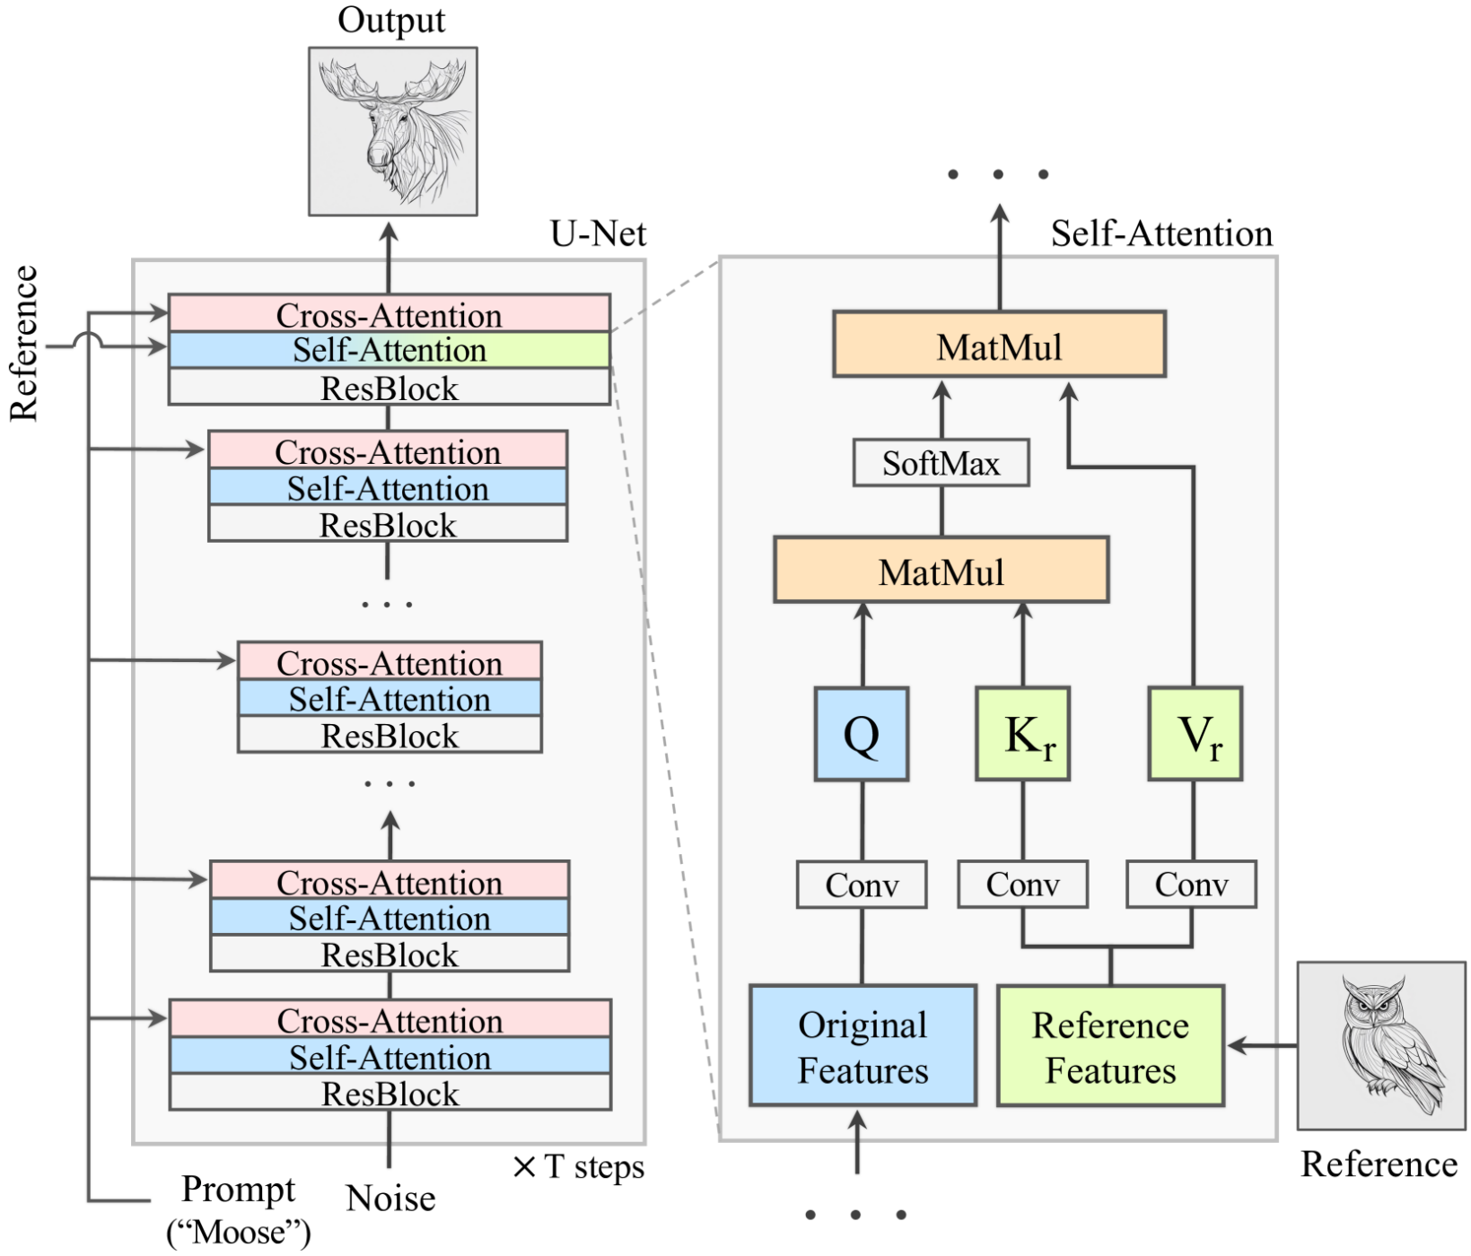
Latent Diffusion Models (LDM)
Latent Diffusion Models (LDM)
For conditional generation;
We use cross attention!
Condition
Condition
Denoised image

Slide 9
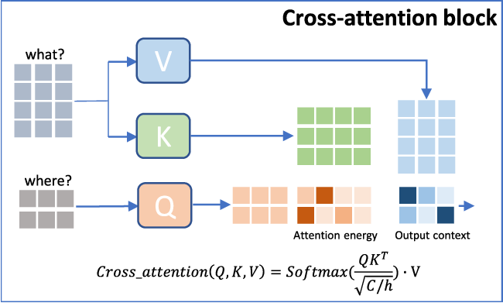
Latent Diffusion Models (LDM)
Cross Attention

Slide 10
Use cases
Text to Images
Image to Image
Inpainting

Slide 11
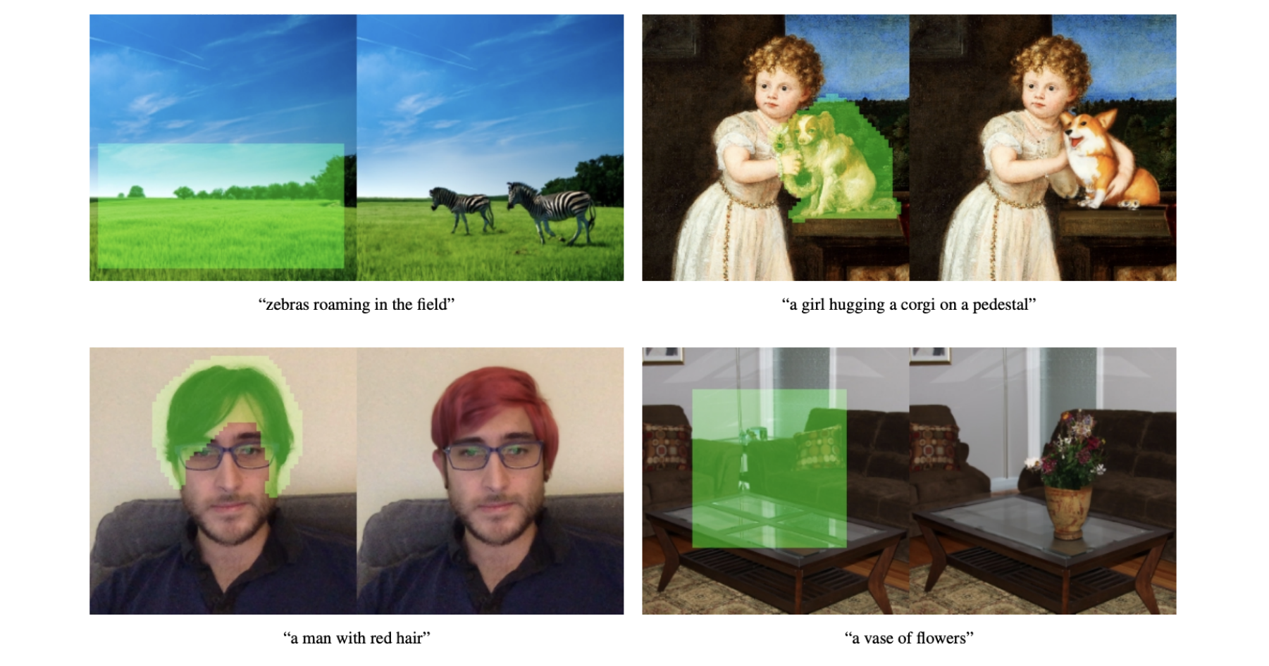
Text to Image

Slide 12
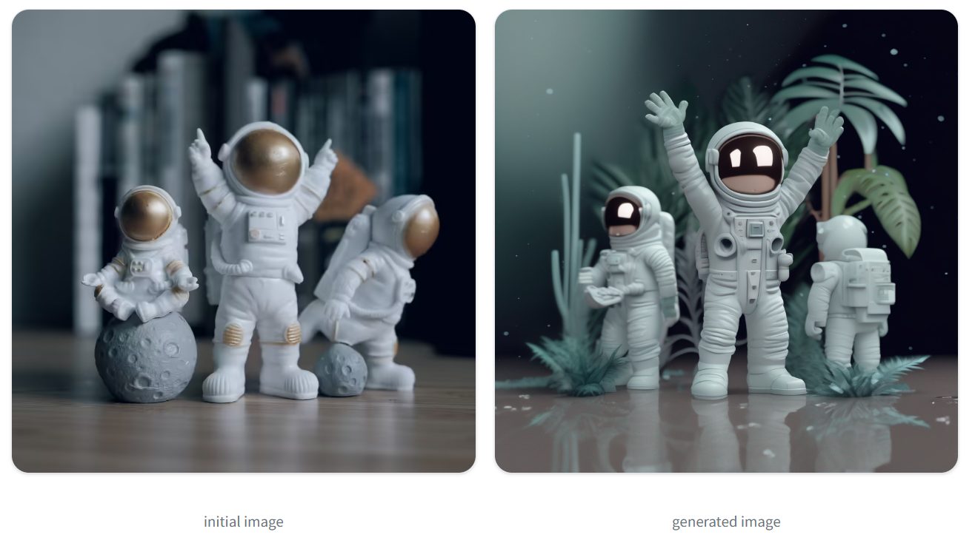
Image to Image
You can also pass an initial image as a starting point for the diffusion process.

Slide 13
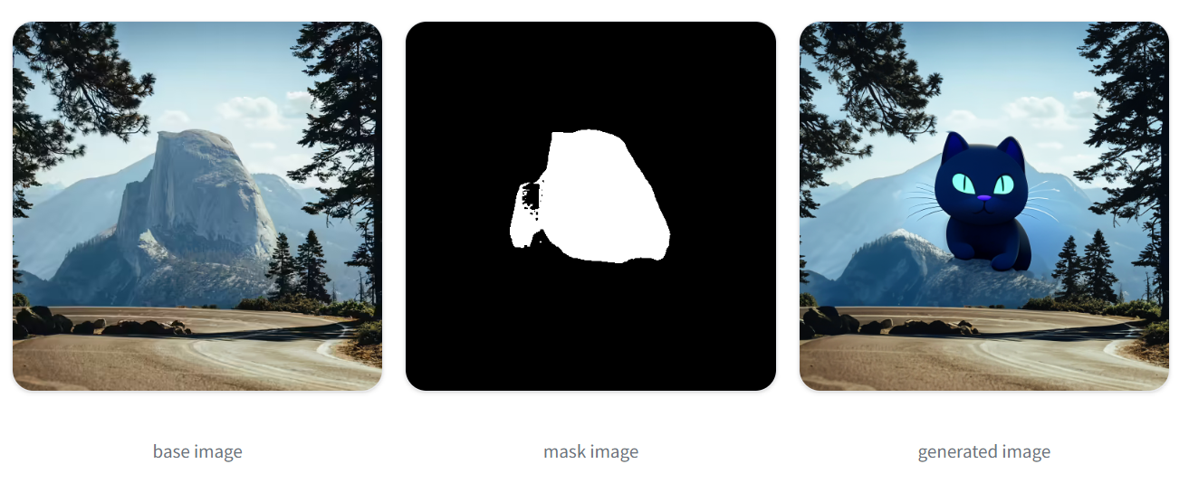
Inpainting
Prompts
"a black cat with glowing eyes, cute, adorable, disney, pixar, highly detailed, 8k"
Mask: The area to inpaint.

